Slide 1

CS 533 INTRO TO DATA SCIENCE
Michael Ekstrand

Slide 2
TEXT PROCESSING PIPELINE

Slide 3

Learning Outcomes
Understand the different stages of text processing
Extract vectors from text
Know some of the things that are possible beyond what we will discuss in class
Photo by Andrej Lišakov on Unsplash

Slide 4
Text Processing
Input:
Someone must have slandered Josef K., for one morning, without having done anything truly wrong, he was arrested.
Output:
Features
Vectors
Scores
Decisions

Slide 5
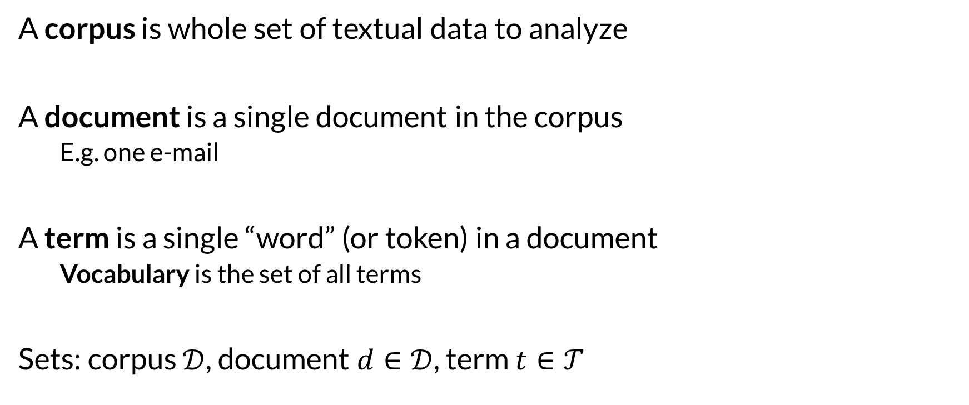
Corpus
A corpus is whole set of textual data to analyze
A document is a single document in the corpus
E.g. one e-mail
A term is a single “word” (or token) in a document
Vocabulary is the set of all terms
Sets: corpus $𝒟$, document $d∈𝒟$, term $t∈𝒯$

Slide 6
Text Processing Pipeline (term vector)
Decode
Normalize Text
Tokenize
Remove Stop Words / Filter Tokens
Stem / Lemmatize
Vectorize Text
Normalize Vectors
<do more things>

Slide 7
Decoding and Normalization
See previous video
May delay normalization until after tokenization

Slide 8

Tokenization
Split text into individual tokens
For now: words (sequences of alphanumeric characters)
someone must have slandered josef k.
someone must have slandered josef k

Slide 9
Remove Stop Words
Common utility words not useful for many tasks
And, or, but, if, etc.
Can remove with:
List of stop words
Frequency (words appearing in most documents)
Whether you do this depends on task

Slide 10
Stemming and Lemmatiziation
“change”, “changes”, “changed”, “changing” — all the same word
Stemming transforms word forms into common stems
Not necessarily a word (e.g. ‘chang’)
Different forms will have the same stem
English: snowball is a common algorithm
Lemmatization transforms words into ‘lemma’ form
Normalizes to an actual word (e.g. “change”)
More computationally intensive

Slide 11
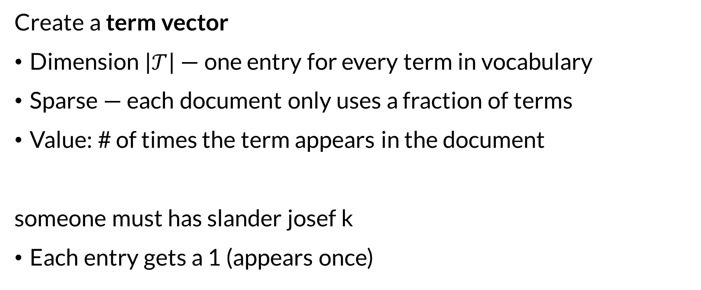
Vectorizing
Create a term vector
Dimension $\left|𝒯\right|$ — one entry for every term in vocabulary
Sparse — each document only uses a fraction of terms
Value: # of times the term appears in the document
someone must has slander josef k
Each entry gets a 1 (appears once)

Slide 12
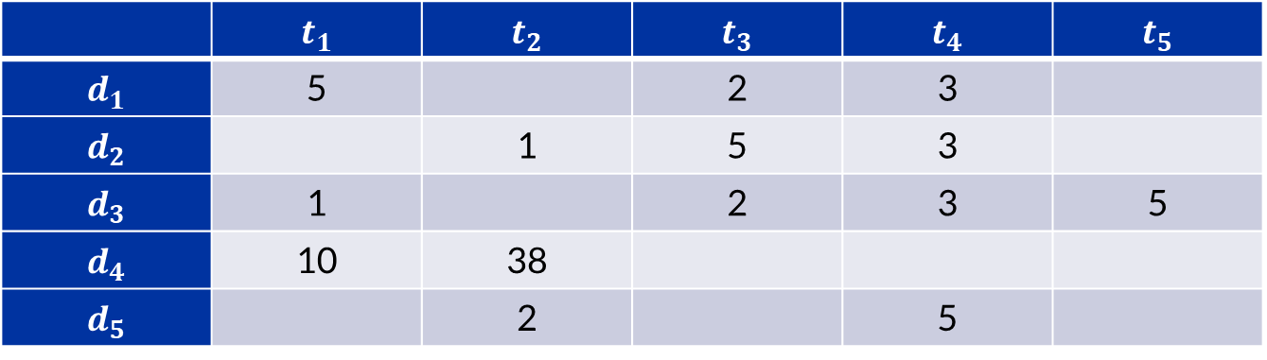

SciKit CountVectorizer
The SciKit-Learn CountVectorizer gets us to this stage
fit() learns vocabulary
transform() turns array of text into (sparse) matrix
 | $$t_{1}$$ | $$t_{2}$$ | $$t_{3}$$ | $$t_{4}$$ | $$t_{5}$$
$$d_{1}$$ | 5 |  | 2 | 3
$$d_{2}$$ |  | 1 | 5 | 3
$$d_{3}$$ | 1 |  | 2 | 3 | 5
$$d_{4}$$ | 10 | 38
$$d_{5}$$ |  | 2 |  | 5

Slide 13
CountVectorizer pipeline
Decode (if necessary)
Lowercase (optional)
Strip accents (optional, also normalizes Unicode)
Tokenize (default: 2+ alphanumeric characters are a word)
Vectorize (values are term frequencies)

Slide 14
Problems with Term Frequency
All words equally important
Count vector has higher values just for longer documents
Solution?
Weigh words differently
Uncommon words higher weight? More likely useful for classification!
Normalize to use relative frequency instead of absolute count

Slide 15
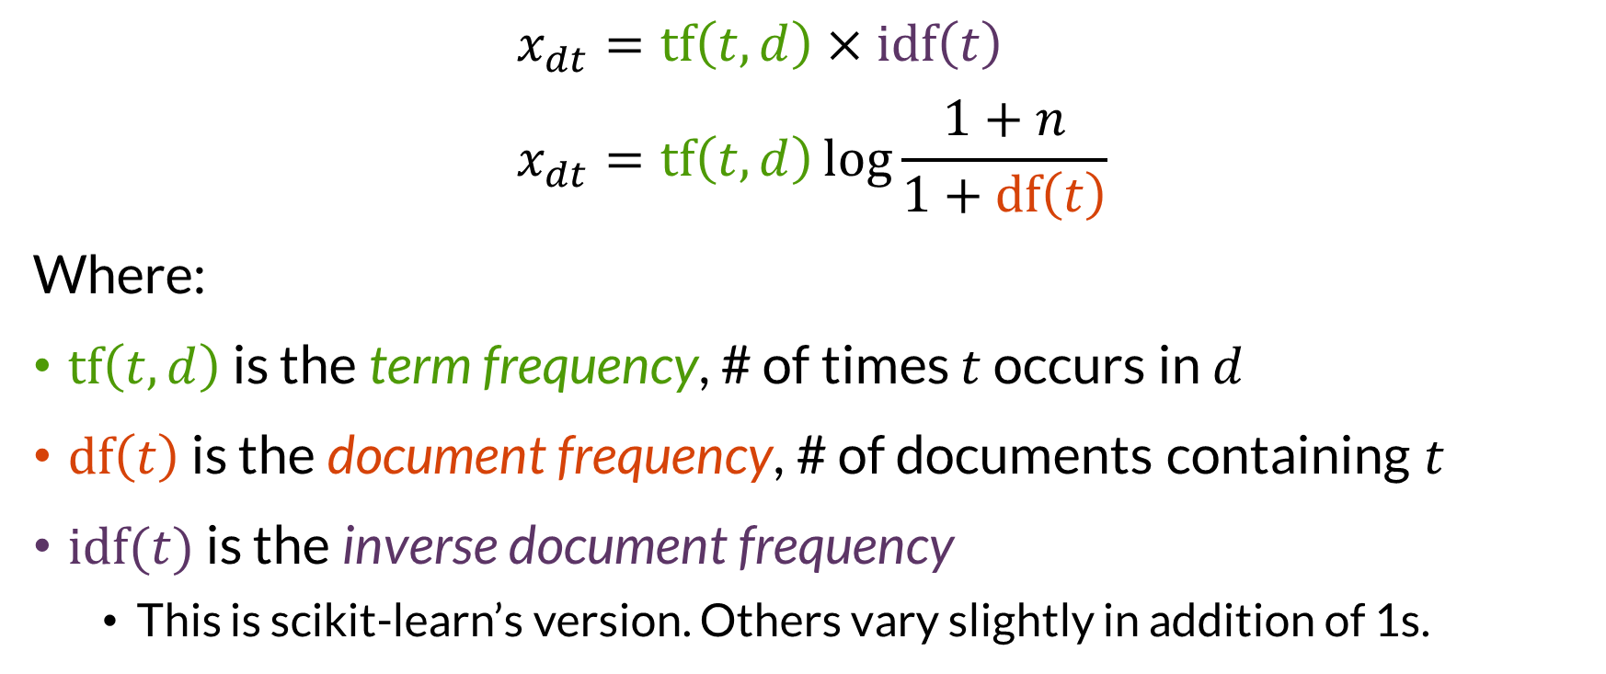

TF-IDF
$$x_{dt}=tf\left(t, d\right)×idf\left(t\right) \\ x_{dt}=tf\left(t, d\right)\log{\frac{1+n}{1+df\left(t\right)}}$$
Where:
$tf\left(t,d\right)$ is the term frequency, # of times $t$ occurs in $d$
$df\left(t\right)$ is the document frequency, # of documents containing $t$
$idf(t)$ is the inverse document frequency
This is scikit-learn’s version. Others vary slightly in addition of 1s.

Slide 16
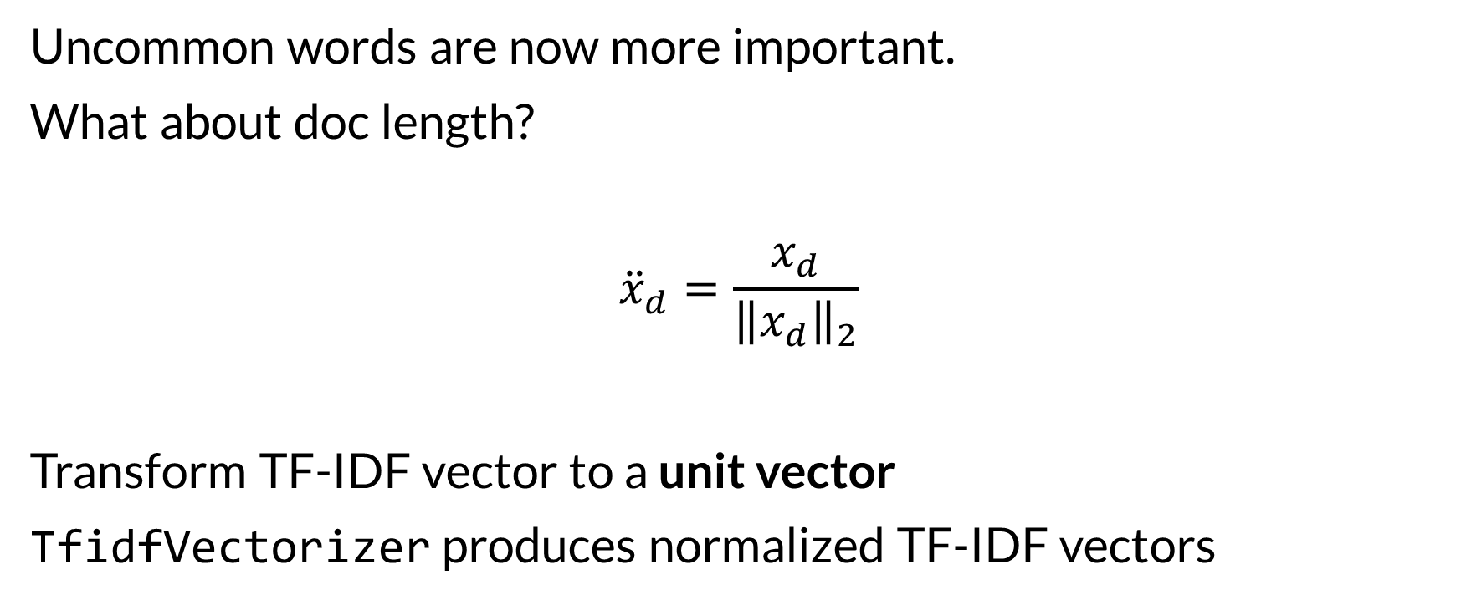
Normalized TF-IDF
Uncommon words are now more important.
What about doc length?
$${\ddot{x}}_{d}=\frac{x_{d}}{{\left\|x_{d}\right\|}_{2}}$$
Transform TF-IDF vector to a unit vector
TfidfVectorizer produces normalized TF-IDF vectors

Slide 17
Text Processing Pipeline (term vector)
Decode
Normalize Text
Tokenize
Remove Stop Words / Filter Tokens
Stem / Lemmatize
Vectorize Text
Normalize Vectors
Result: each document has a vector assigning scores to terms

Slide 18

Alternatives
N-grams (e.g. bigrams) instead of words
Either words or characters
Sentence-level analysis
Two-level tokenization: words and sentences
Tag words by part of speech
Analyze relationships between words
Transformer architectures
Neural nets for sequences of words
Significant power, significant processing cost
nltk provides a lot of capabilities, can integrate with scikit-learn

Slide 19

Wrapping Up
Term vectors treat each word as a feature, for which documents have scores.
Often normalized to give uncommon words higher weight, and for document length.
Photo by Jael Rodriguez on Unsplash

